Slide 1


Unstructured to structured information conversion for extracting meaningful clinical information from medical notes
Awanish Ranjan
Rabindra Bista
Dept. of Computer Science and Engineering
Kathmandu University
Nepal
Notes:
Title Slide

Slide 2
Contents
Introduction
Objectives
Methods
Results
Discussion and Coclusion
References
Notes:
Slides contents

Slide 3
Introduction
Medical notes – Rich of clinical information like
  diagnosis
  Procedure
  Family History
  Drug etc.
NLP (Natural Language Processing) techniques
Clinical domain
Difficulty
  Use of abbreviations like dr., pt., dx, rx. etc.
  Ambiguity
  Not always following correct grammar rules
Notes:
Introduction about medical notes
To solve the problem, we are going to use NLP techniques
The research is associated with clinical domain
Major hurdles of the research

Slide 4
Introduction
Unstructured information –
  Texts not following any pre-defined structure to store information
  E.g. –
    1. Spoke with pt over the phone. Pt presents with fairly new dx of diabetes, currently not any meds. States this happened about 2 yrs ago and was able to control blood sugars with diet and exercise.
    2. Pt presents with hyperlipidemia and strong family hx of CAD. Keeps active with job, kids, and softball, but no routine cardio exercise.
Notes:
Introduction of unstructured texts and examples

Slide 5
Introduction
Disadvantages of Unstructured text
  No regular pattern and structure like the order of occurrence of information
  So many abbreviated texts
  Tedious to read all notes manually and get information
  Time consuming
  Can’t be automated for further analysis
Notes:
Disadvantage of unstructured texts –
Only manual analysis is possible, can’t be automated
Very tedious

Slide 6
Introduction
Structured Information-
  the information stored in a regular and general pattern not haphazardly
  Stored in a pattern and machine readable format like in database, xml etc.
  E.g. –
    Note 1 -
      Diagnosis - Diabetes from past 2 years
      Medication - Not taking any medicine
      Actions taken - Exercise and controlled diet
      Result - control in blood sugar
    Note 2 -
      Diagnosis - Hyperlipidemia
      Family History - CAD
      Actions - Job, playing softball and being active with kids but no cardio exercise.
Notes:
Structured information introduction with example

Slide 7
Introduction
Advantage of Structured Information-
  Easily interpreted by computer system for further processing.
  Information extraction with accuracy and speed
  Further processing like report generation, suggesting corrective actions etc.
  No tedious manual work and can be done way much faster
Notes:
Advantages of structured information –
Automatic processing
No manual task to analyze so fast and accurate

Slide 8
Structured Output format
Patient Notes | Structured Info. | Examples
 | PROBLEM_TIME
 |  | 2 Yrs
 | STATE
 |  | VITALS : Blood Sugar 150
 | DIET_HABIT
 |  | Diet off track
 |  | watching diet
 |  | excercising
 | DIET_COMPOSITION
 |  | Miracle Green
 |  | Green Vegetables
 |  | Water foods
 |  | Fat Diets
 |  | vitamin Supplements
 |  | Fibre food
 |  | Mono sat fats
 | DIAGNOSIS
 |  | Diabetes
 | TESTS
 |  | Eye Exam
 |  | Dental Exam
 |  | Foot care
 | ADVICE
 |  | Followup appointment
 |  | Take Diabetic meds
 | MEDICATION
 |  | none
Notes:
The structured output format with examples

Slide 9
Objective
Find out the appropriate method of converting unstructured text to structured information
Extract meaningful clinical information from notes entered by medical practitioner
Store the information for future use
Study of appropriate Natural Language Processing methods
Implement the appropriate NLP technique to solve the problem
Notes:
Objectives of research

Slide 10
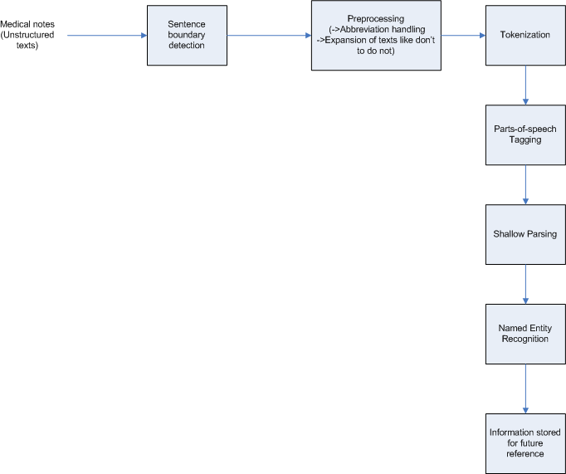
Method
Use of NLP techniques to solve the problem
Block Diagram
Notes:
Block diagram of proposed system
Sentence boundary detection - In this step, the sentences from clinically rich texts is identified. It detects sentences by using sentence terminators like period (.), question mark (?) etc.
Preprocessing - This is the very first step where we are going to handle the abbreviation and remove punctuation so that we get a complete standard text for analysis.
Tokenization - This steps breaks the sentence into smallest unit (usually words). For detecting tokens, it uses delimiters like space, comma etc.
Parts-of-speech tagging (POS tagging) - This step assigns parts-of-speech to each token.
Shallow parsing - A shallow par1ser segments a sentence into meaningful phrases like noun phase, verb phrase etc.
Named Entity Recognition - Named entity recognition classify tokens in text into different categories such as person, diagnosis, procedure, drugs etc. For this case, we build a medically suitable corpus using some standard medical library (UMLS - Unified Medical Language System)
Information stored for future reference - The structured text extracted then can be stored in database or xml format for future use like generating reports, suggesting appropriate path of action for patient and so on.

Slide 11
Results
Result of Sentence boundary detection –
  Sample Note -
  "Spoke with pt over the phone. Pt presents with fairly new dx of diabetes, currently not any meds. States this happened about 2 yrs ago and was able to control blood sugars with diet and exercise."
  Split into individual sentences enclosed within single quote and separated by comma.
  ['Spoke with pt over the phone.', 'Pt presents with fairly new dx of diabetes, currently not any meds.', 'States this happened about 2 yrs ago and was able to control blood sugars with diet and exercise.']
Notes:
Sentence boundary detection – Detects individual sentences from text based on the sentence terminators like period (.), question mark (?) etc.

Slide 12
Results
Result of Preprocessing
  Original Sentence >>> Pt presents with fairly new dx of diabetes, currently not any meds.
  Preprocessed Sentence>>>:Patient presents with fairly new diagnosis of diabetes, currently not any medication. <<<
Notes:
Results of preprocessing – Expands the abbreviation using a dictionary.

Slide 13
Results
Result of Tokenization
  Patient
  Presents
  With
  Fairly
  New
  Diagnosis
  Of
  Diabetes
  ,
  Currently
  Not
  Any
  medication
Notes:
Tokenization result – separating individual tokens (words) from the text. It is based on space.

Slide 14
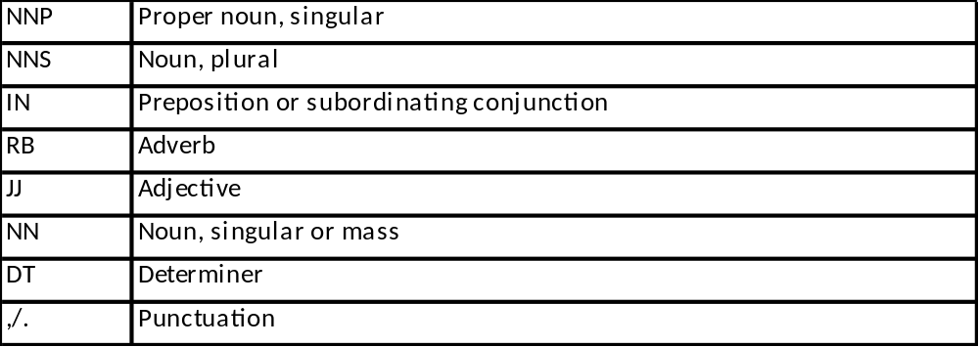
Results
Result of POS Tagging
  *****POS Tagging [using Penn Treebank tagging]****
  ('Patient', 'NNP') ('presents', 'NNS') ('with', 'IN') ('fairly', 'RB') ('new', 'JJ') ('diagnosis', 'NN') ('of', 'IN') ('diabetes', 'NNS') (',', ',') ('currently', 'RB') ('not', 'RB') ('any', 'DT') ('medication', 'NN') ('.', '.')
Notes:
POS tagging – Tags each word with appropriate Parts of speech. This is based on “Penn Treebank” tagging.

Slide 15
Results
Result of Shallow parsing and Named Entity Recognition –
  (S
  (GPE Patient/NNP)
  presents/NNS
  with/IN
  fairly/RB
  new/JJ
  diagnosis/NN
  of/IN
  Diseases diabetes/NNS
  ,/,
  currently/RB
  not/RB
  any/DT
  Drug medication/NN
  ./.)
Notes:
Named Entity Recognition – Recognition of relevant terms. Here Black marked texts are recognized as relevant named entity.
GPE stands for the entity recognized as either Geographic location or person or Enterprise.

Slide 16
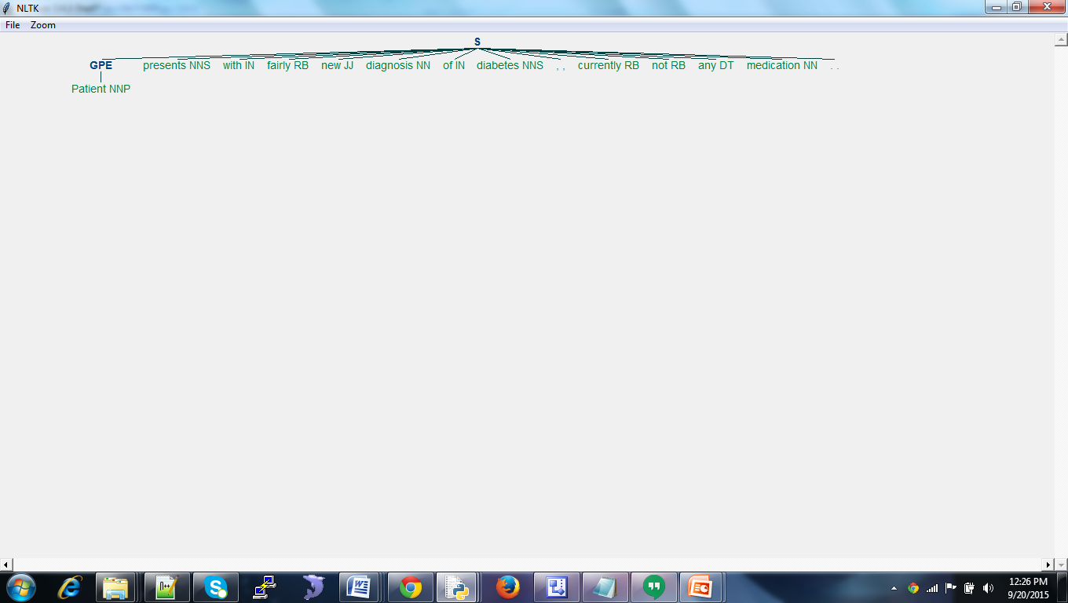
Results
Parse Tree
Notes:
Output of parse tree generated via python NLP toolkit.

Slide 17
Discussion and Conclusion
Ambiguity
  One text carrying multiple meanings
  E.g. - Member has had two strokes.
    Member has played two cricket strokes (cricket shot).
    Member has written two strokes using pencil.
    Member has had heart attack.
    Member had brain stroke.
  Need to analyze the context of sentence
  Probabilistic approach –
    Conditional Probability
    Probability of occurrence of text based on previous text and finds the highest probability of occurrence
Notes:
Discussion of difficulties and future direction -
Ambiguity with example and solution approach to it

Slide 18
Discussion and Conclusion
Lack of suitable medical corpus
  Need to build a well defined corpus to refine Medical Named Entity Recognition
Training –
  Whole dataset is divided into 80-20 ratio
  First 80% of dataset is used for training data and refining the algorithm
  The next 20% data is used for test data
Notes:
Challenges and future direction (continued)
No suitable medical corpus, needing to build relevant curpus
Designing training to increase the accuracy – 80-20 approach, for example, for 100 notes, take 80 notes to test the system. This is called test set. The remaining 20 notes which is yet unseen by system, use that for training purpose and see if those 20 notes are converted to the structured information accurately.

Slide 19
References
1. Xu, H.; Stenner, S.P.; Doan,S.;Johnson, K.B.; Waitman,L.R.;Denny, J.C MedEx: a medication information extraction system for clinical narratives; Journal of the American Medical Informatics Association (JAMIA), 2009; pp. 19-24
2. Savova G.K,; Masanz,J.J.; Ogren, V.P.; Zheng, J.; Sohn, S.; Kipper-Schuler, C.K.;Chute, G.C. Mayo clinical Text Analysis and Knowledge Extraction System (cTAKES): architecture, component evaluation and applications; ; Journal of the American Medical Informatics Association (JAMIA), 2010; pp. 507-513.
3. Garla, V.; Re, L.V. III; Dorey-Stein, Z.; Kidwai, F.; Scotch, M.; Womack,J.; Justice,A.; Brandt,C. The Yale cTAKES extensions for document classification: architecture and application Journal of the American Medical Informatics Association (JAMIA), 2011; pp. 1-7
4. Liddy, E.D. Natural Language Processing; Encyclopedia of Library and Information Science 2nd Edition,2001

Slide 20
References
5. Ronan Collobert, R.; Weston, J.; Bottou, L.; Karlen, M.; Kavukcuoglu,K.; Kuksa, P. Natural Language Processing (Almost) from Scratch; Journal of Machine Learning Research 12, 2011
6. Wolniewicz, R. Auto-Coding and Natural Language Processing; 3M Health Information Systems
7. Madnani, N.; Getting Started on Natural Language Processing with Python
8. Wu, Y.; Denny, C.J; Rosenbloom, S.T.; Miller, R.A.; Giuse, D.A.;Dr.Ing; Xu, H. A comparative study of current clinical natural language processing systems on handling abbreviations in discharge summaries; Department of Biomedical Informatics, Department of Medicine, School of Medicine, Vanderbilt University, Nashville, TN
9. Bodenreider, O.; Willis, J.; Hole, W. The Unified Medical Language System; National Library of Medicine, 2004
10.Klassen, P. Gate Overview and Demo; University of Washington CLMA treehouse Presentation, 2010

Slide 21
References
11.OpenNLP, URL - https://opennlp.apache.org/ (visited on December 2014)
12. NLTK, http://www.nltk.org/book/ (visited on August 2015)
13. http://sujitpal.blogspot.com/2013/04/language-model-to-detect-medical.html (visited on August 2015)
14. http://nlp-mentor.com/ambiguities/ (visited on September 2015)
15. https://www.packtpub.com/books/content/python-text-processing-nltk-20-creating-custom-corpora (visited on August 2015)
16. Coffman, A.; Wharton, N.; Clinical Natural Language Processing Auto-Assigning ICD-9 Codes;2007
17. Jurafsky, D.; Martin, J.H.; Speech and Language Processing; second edition

Slide 22
Thank You !!

